Slide 1

Can we build individual molecules atom by atom? Lecture 2

Slide 2
Yesterday we
Talked about two-level atoms in light
Optical trapping of atoms
Laser cooling of atoms
Dave explained how to cool all the way to the ground state (Same thing works for a single neutral atom in an optical micro-trap)
Found that the students do not participate much in the lectures
This provide the initialisation step of our atoms.

Slide 3
What is the difference between molecular physics and chemistry?

Slide 4
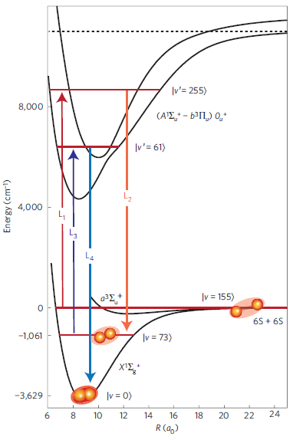
Basic molecular physics

Slide 5
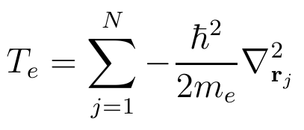


The Hamiltonian

Slide 6
Nuclear equation

Slide 7


Separate S. E. Equations
Nuclear motion:
Electrons. For all R solve:

Slide 8
Basic molecular physics

Slide 9
We start from

Slide 10
A bit of algebra

Slide 11
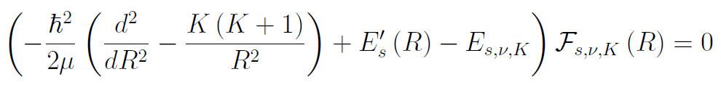
We arrive at

Slide 12
Two conclusions
Di-atomic molecules are indeed “physics”
But the physics is very rich

Slide 13
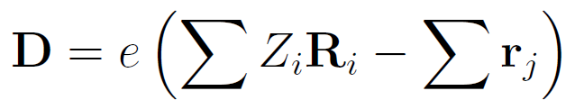
Dipole operator for molecule

Slide 14
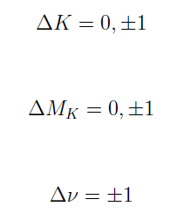
Selection rules for transitions that do not change electronic state:
Hetero nuclear:
Homo nuclear: No allowed transitions

Slide 15
Franck-Condon Principle Different electronic states

Slide 16
